Slide 1
Come Fly With Me
An insight into aviation traffic within Australia

Slide 2
Why is aviation important?
Aviation is a growing necessity in keeping our modern world connected
Australia is especially reliant on aviation due to a lack of land borders

Slide 3
Aims
Investigate seasonal patterns in activity
Find growing hotspots in Australia

Slide 4
Data Source

Slide 5
Aviation statistics are published by the Bureau of Infrastructure, Transport, and Regional Economics (BITRE)
International & domestic activity are both available

Slide 6
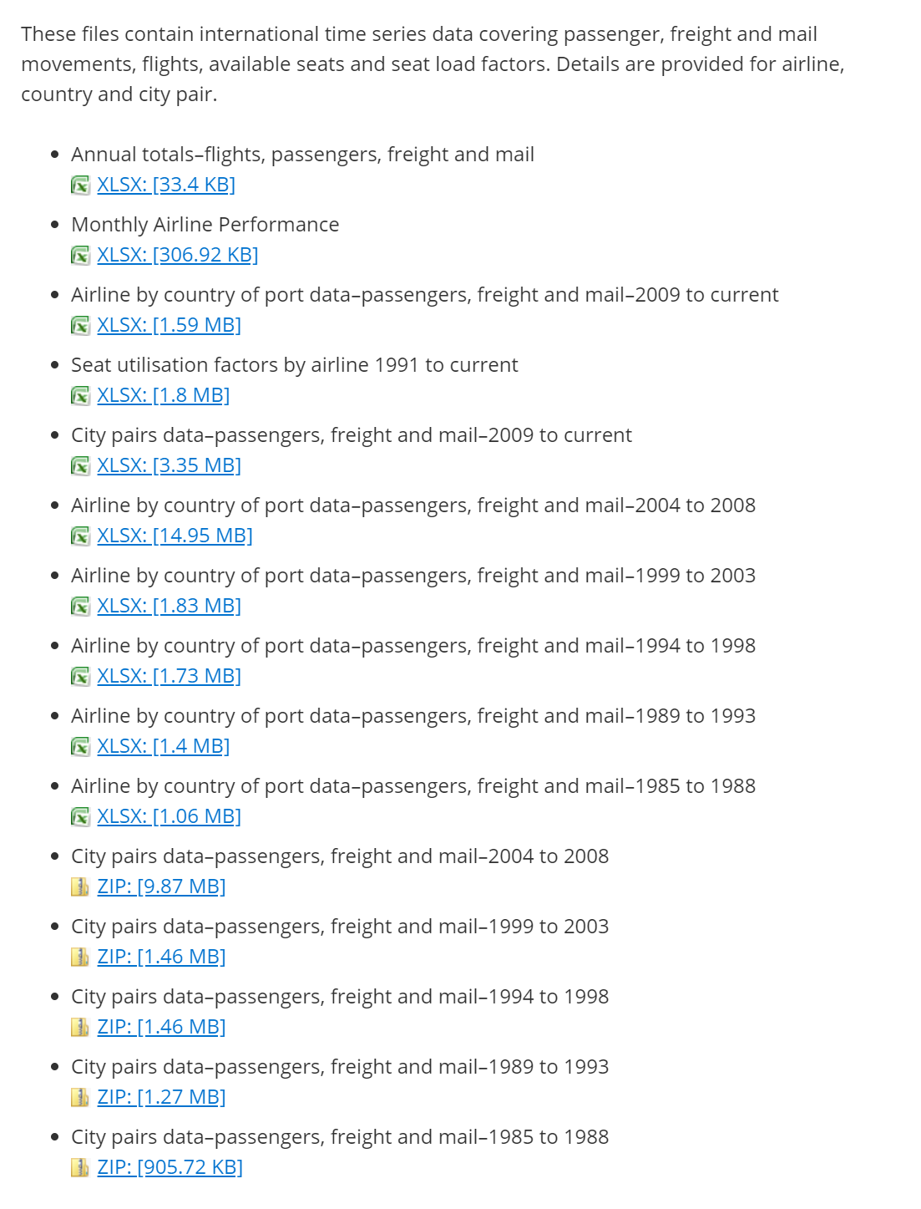
International
City pairs datasets are the most interesting

Slide 7
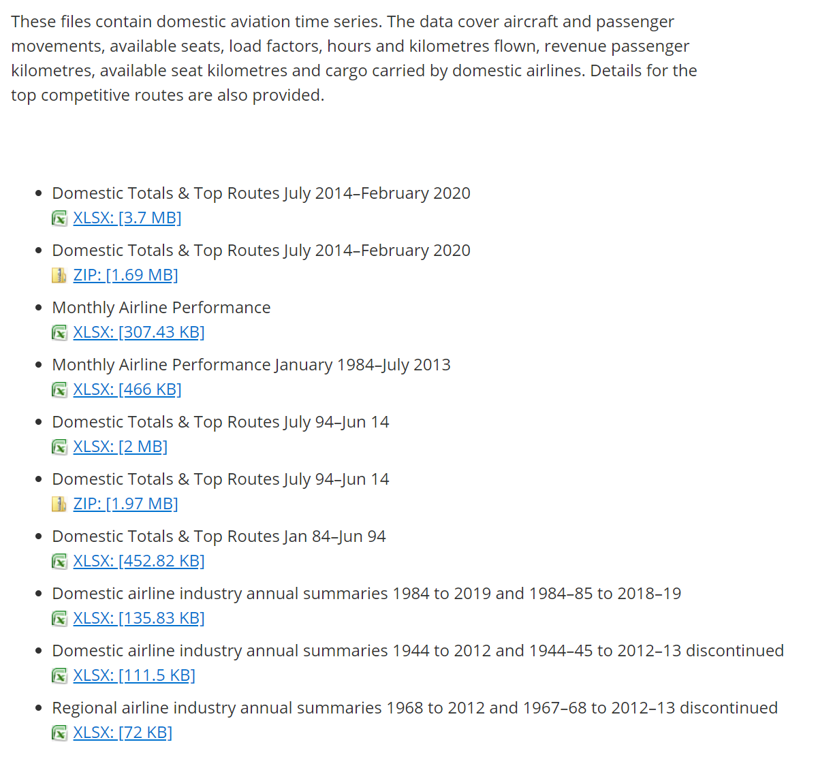
Domestic
Domestic Top Routes is similar to the International City Pairs data

Slide 8
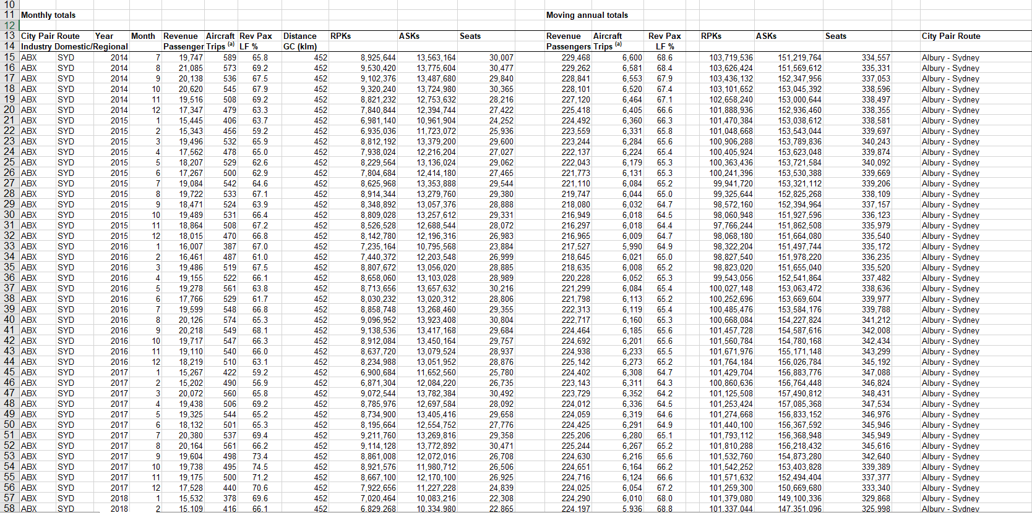

Slide 9
Processing

Slide 10

pandas used to combine excel spreadsheets into a data frame
Remove unnecessary columns while importing

Slide 11

xarray provides fantastic n-dimensional arrays
Pandas data is then converted to an xarray structure – simplifying working with multidimensional data

Slide 12
Initial Visualizations

Slide 13
Initial Visualizations
Important part for initial visualizations is to see overall Australian trends at a glance

Slide 14
Initial Visualizations
Important part for initial visualizations is to see overall Australian trends at a glance
To understand individual airports, it’s important to understand Australia as a whole

Slide 15
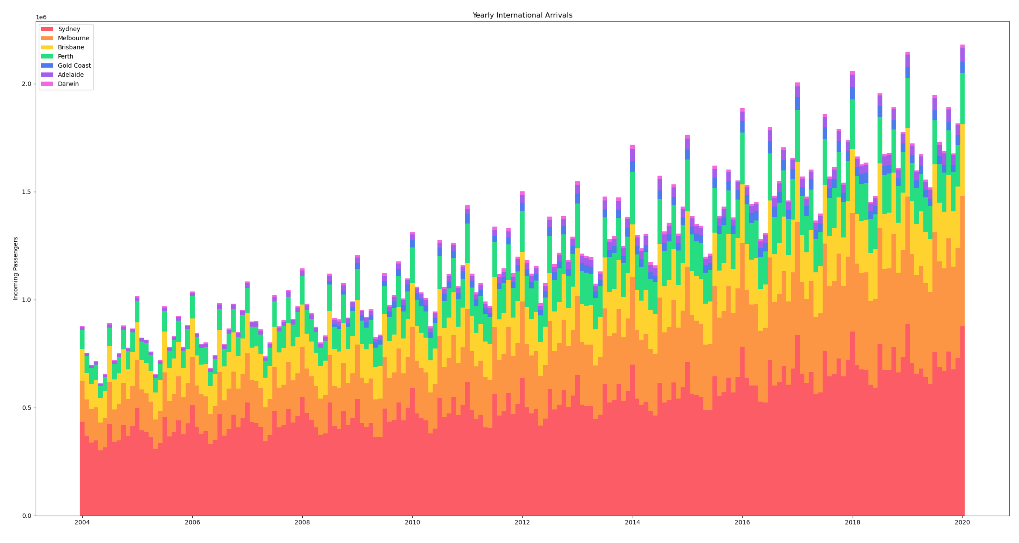
Yearly Arrivals
Stacked bar chart showing total arrivals in Australia each month
Arrivals are trending upward as times goes on
Volume oscillates on a seasonal basis

Slide 17
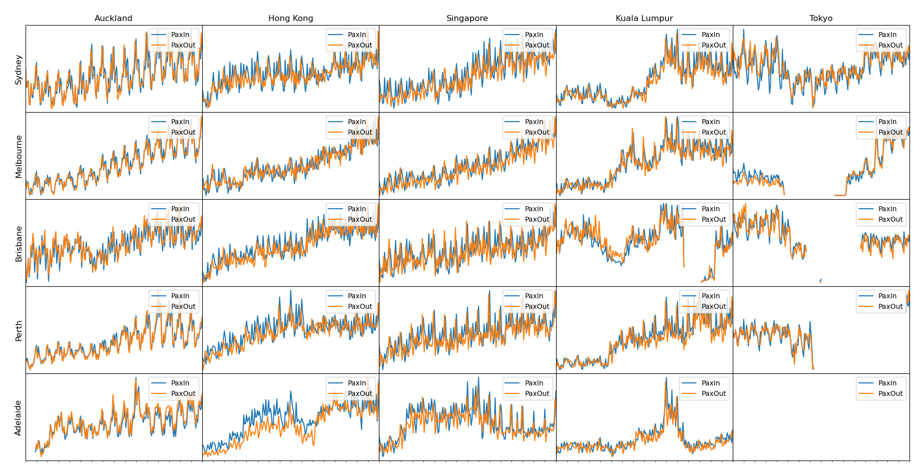
Trends
Trend graphs between various locations in Australia and international hotspots
Axes between charts are not to scale – trends only!
Similar upwards trend is visible
Seasonal fluctuations are more pronounced

Slide 19
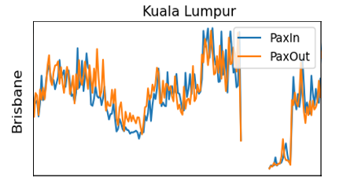
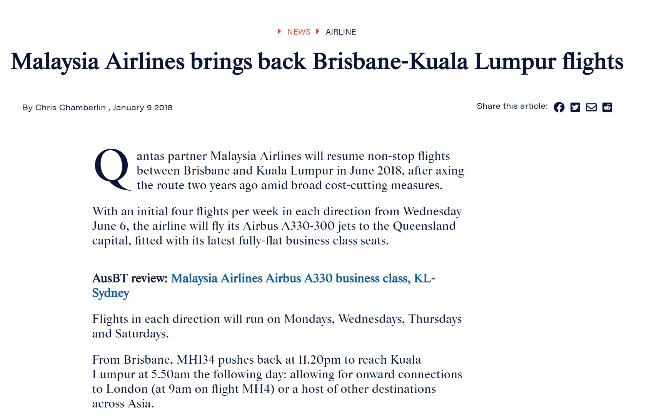
Trends
Certain events can have major impacts in the data

Slide 20
Trends
Is there a better way to view the seasonal trends?

Slide 21
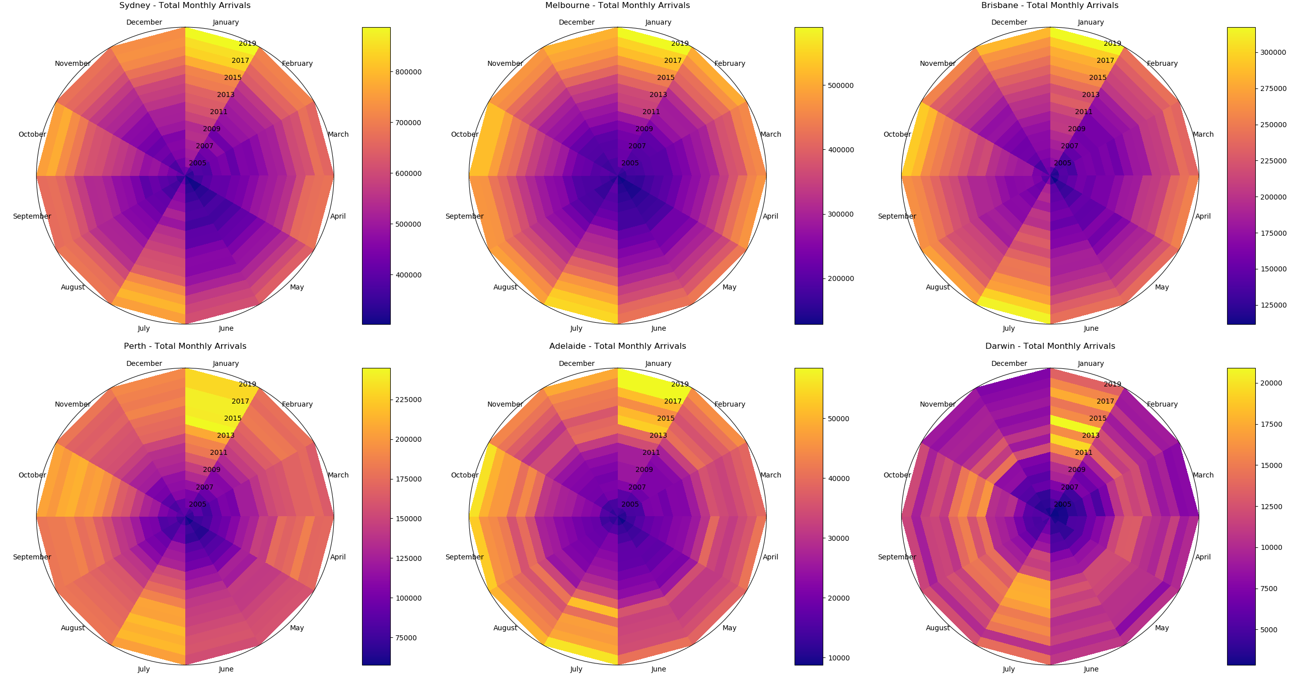

Slide 22
